Slide 1
Goods Merchant

Slide 2
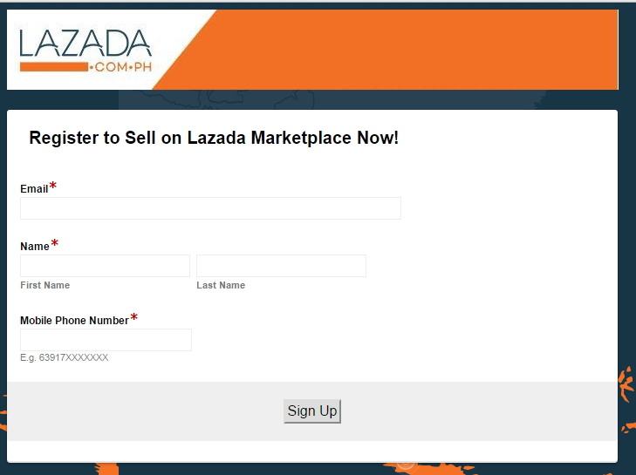

Slide 3
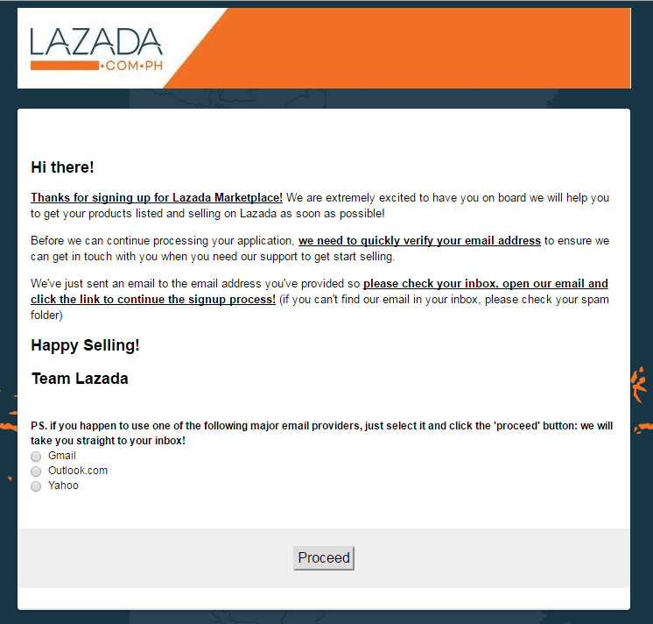
Hi there !
Thank you for signing up! We welcome you aboard to Goods Marketplace where we will delightfully help you get your products listed and selling on Goods PH right away!
Wait up! We have to verify your email address first to ensure we can contact you when you need our help to start selling before we can proceed processing your application.
We’ve send a confirmation email to your provided email address. Please check your inbox and confirm email verification to continue your signup process!
Happy Online Selling!
Goods PH Team
If you want us to take you straight to your inbox, just select one of the following email providers and click the ‘proceed’ button!
Gmail
Outlook
Yahoo

Slide 4
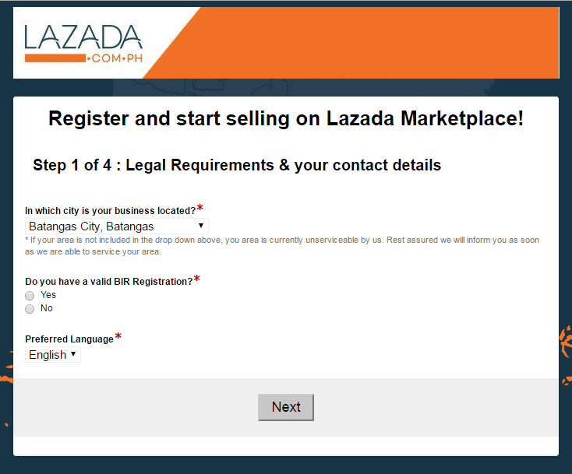
In which city is your business located?
*If your business area is not included in the list, it means your area is not serviceable by us. We will inform you as soon as possible when the area is already serviceable.
Do you have a valid BIR or DTI Registration?

Slide 5
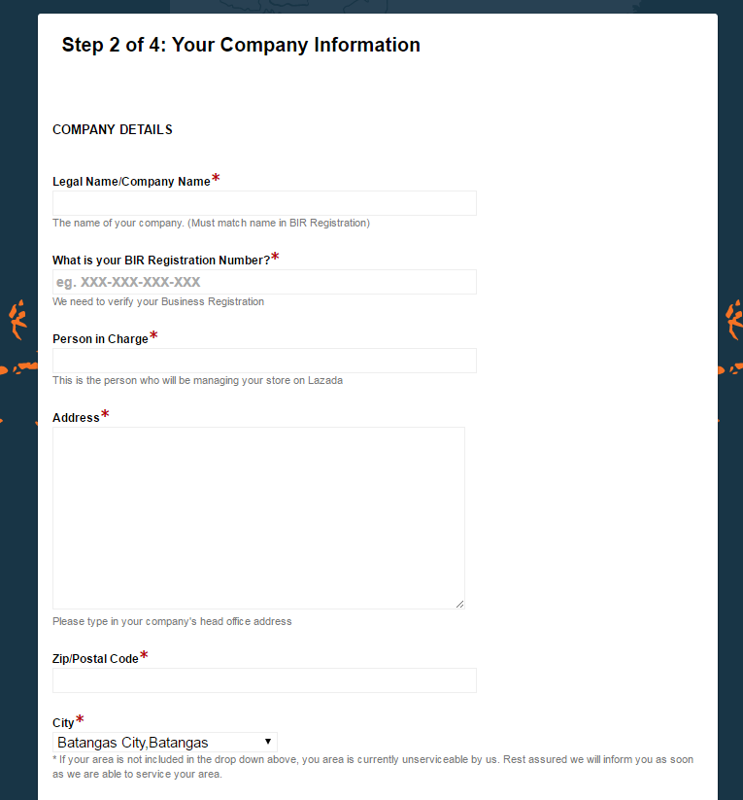
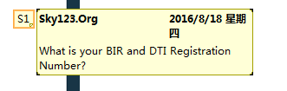

Slide 6
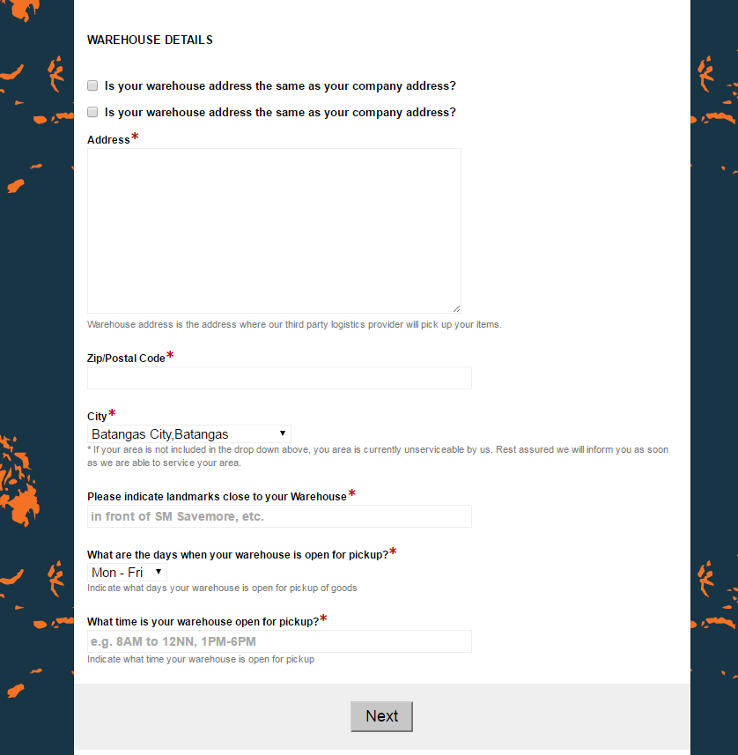
Storehouse Details
Is your storehouse address similar as your company address?
Storehouse address is the address where our third party logistics provider will pick up your items

Slide 7
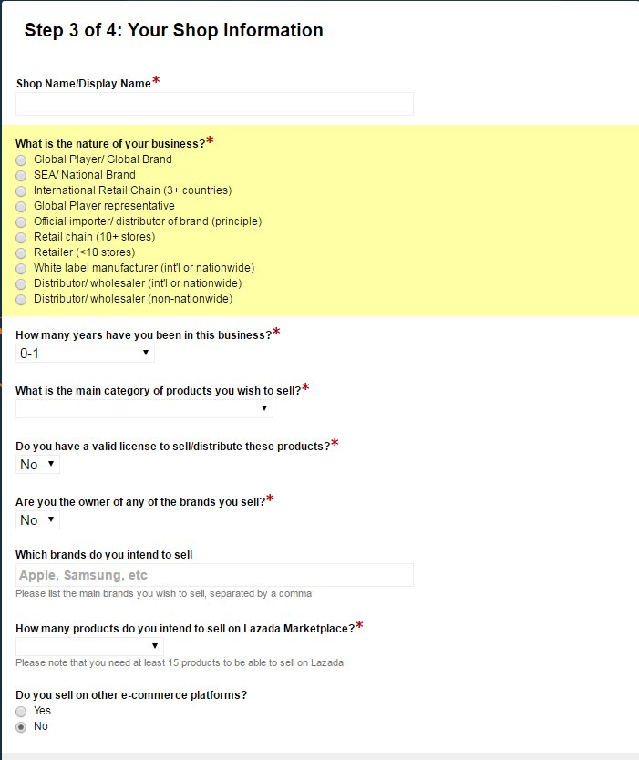

Slide 8
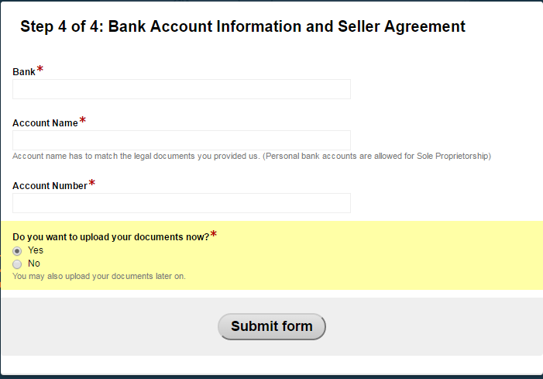
Would you like to upload your documents now?
You can also upload your documents later.

Slide 9
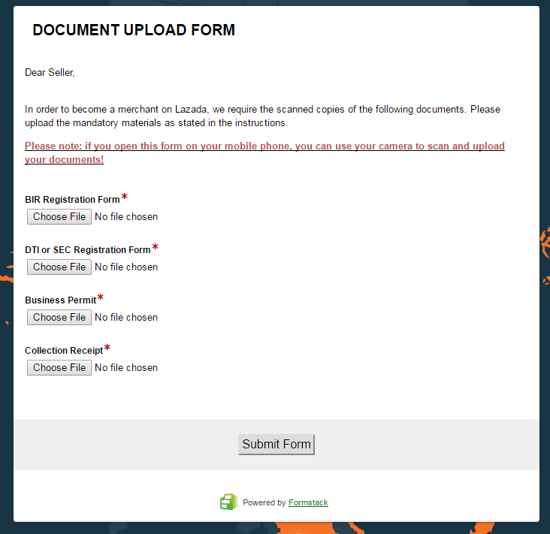
Dear Seller,
In order of becoming a merchant on Goods, we require you to scan copies of the following documents. Please provide the required materials as stated in the instructions.
*If you open this form via mobile, you may use your camera to scan and upload your documents

Slide 10
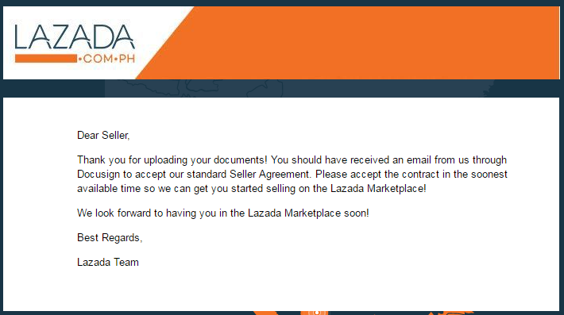
Dear Seller,
You’ve successfully uploaded your documents! We’ve sent you an email through ‘Docusign’ to accept our standard Seller Agreement. Please accept the contract as soon as you can so we can get you started seling on the Goods Marketplace!
Hoping to see you in the Goods Marketplace soon!
Best wishes
Goods PH Team

